Slide 1
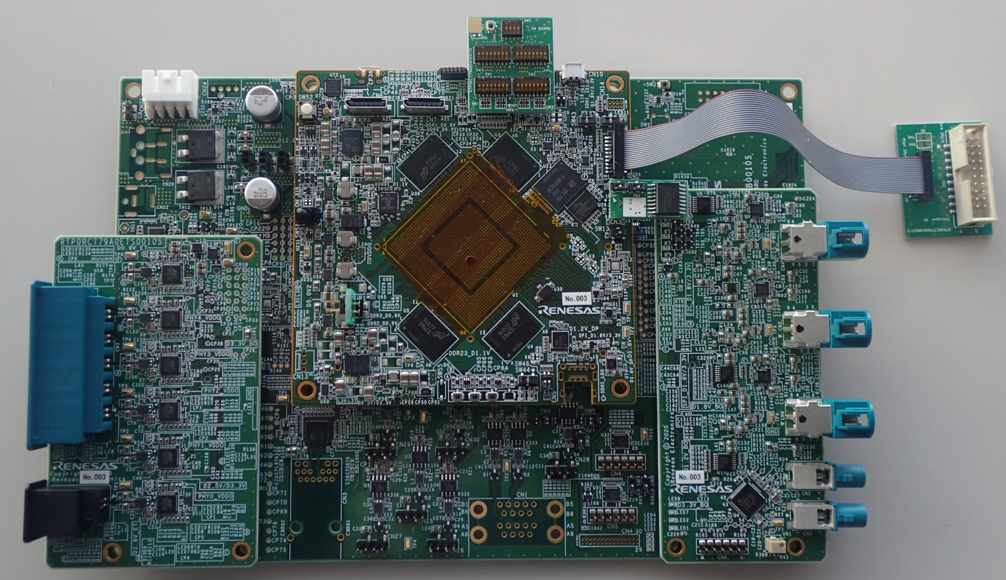
Falcon(V3U) system outline
Debug Console
RL78 Console
(V3U SCIF0/HSCIF0)
(reverse side of CPU board)
RL78 Emulator(E1/E2)
CPLD JTAG
DigiRF
12V in (legacy)
(Break-Out board)
V3U JTAG
FAN,12V,4p
12V in (DIN 4pin jack)
OcuLink
(4ch PCIe, 2lane )
12V in (legacy jack)
R-CarV3U
GMSL in (four cams)
CSI0 and CSI1
(six ch of 1000Base-T1)
AVB5(MATEnet)
GMSL in (four cams)
AVB4(MATEnet)
FAN,5V,3p
CSI2
AVB3(MATEnet)
AVB2(MATEnet)
AVB1(MATEnet)
GMSL in (four cams)
CAN
MSIOF
CSI3
CAN
CAN
GMSL display out (x1)
exAVB0(MATEnet)
MSIOF
exDSI0* and DSI1
(alternative use with AVB0)
CAN
GMSL display out (x1)
CAN
CAN
GPIO
MAX96712 SPI for GMSL radar
AVB0(RJ45)
CAN-FD
Mini DP(DSI0)
*alternative use with DSI0
(alternative use with exAVB0)
(alternative use with exDSI0)
(1000Base-T)

Slide 2
Falcon(V3U) system outline
Switch board(debug only)
JTAG extension cable
Falcon V3U CPU board
Falcon external QSPI flash board
Falcon Break-Out board
JTAG board
Ether sub board
Filter board
(debug only)
CSI/DSI sub board

Slide 3
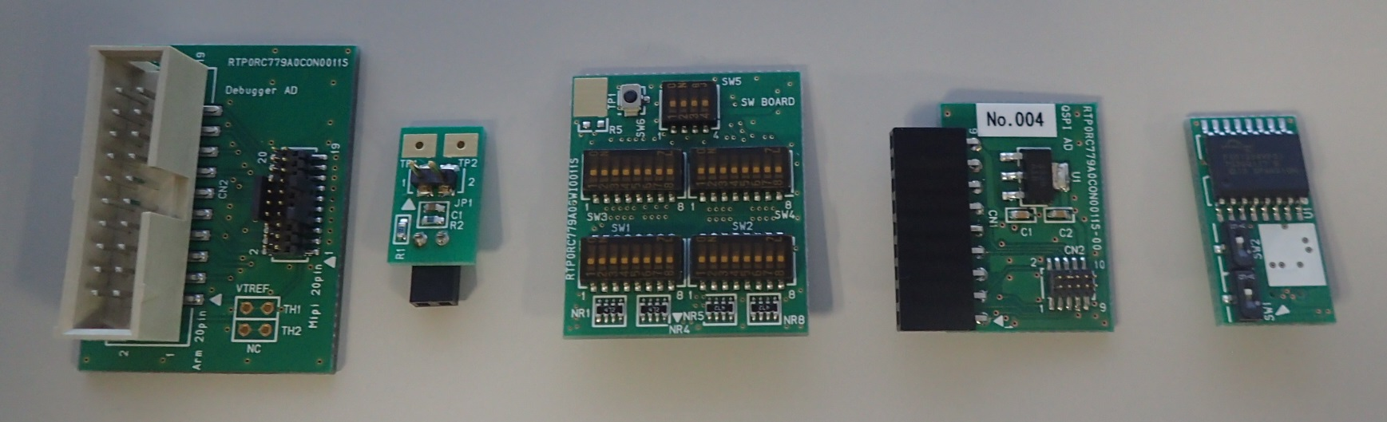
Falcon(V3U) system debugging modules
Connector for JTAG emulator cable
Connector for JTAG extension cable
Switch board(debug only)**
External QSPI adaptor***
Falcon external QSPI flash board
(for legacy gen3 board)
JTAG board
Filter board(debug only)*
* “Filter board” is designed for measurement of actual SOC current.
** “Switch board” is designed for settings SOC operating mode, instead of CPLD.
*** “External QSPI adaptor” is designed for programming “Falcon external QSPI flash board” by legacy gen3 system board like Salvator-X.

